Slide 1



GARBAGE CLASSIFICATION

Slide 2

Learning Objectives
To understand how AI helps in solving real-world environmental issues.
To learn how artificial intelligence and deep learning can classify images of garbage.
To explore the concept of transfer learning using pre-trained models.
Build and evaluate a trash classification model using
To create a real-time prediction interface using Gradio.
To practice deploying and testing an AI model in Google Colab or Jupyter Notebook.
GOAL
Source :
www.freepik.com/

Slide 3
Tools and Technology used
Programming Language: Python
Frameworks: TensorFlow, Keras
Libraries: NumPy, Matplotlib, Scikit-learn
Model Used: MobileNetV2 (Pre-trained on ImageNet)
Interface Tool: Gradio
Environment: Google Colab / Jupyter Notebook
Dataset: Garbage Classification Dataset (images of different waste categories)

Slide 4
Methodology
Data Collection – Gather labeled images for various garbage types.
Preprocessing – Resize, normalize, and augment images.
Model Selection – Use MobileNetV2 via transfer learning.
Training & Fine-tuning – Train model with garbage dataset.
Evaluation – Measure performance using metrics like accuracy and loss.
User Interface – Build a simple and interactive front-end with Gradio.
Deployment – Test and use the model in Colab/Jupyter.

Slide 5
Problem Statement:
Manual sorting of waste is time-consuming and prone to error. Incorrect disposal leads to environmental damage and affects recycling efforts. There is a strong need for an automated, fast, and accurate system that classifies waste types correctly based on image input. The project aims to automate garbage classification using artificial intelligence and deep learning techniques.

Slide 6
Solution:
To propose an AI-based image classification system trained to detect various types of garbage. The system accepts an image through webcam or file upload and classifies it as plastic, paper, metal, glass, or cardboard using a deep learning model.
The interface is built using Gradio and makes predictions in real-time.

Slide 7
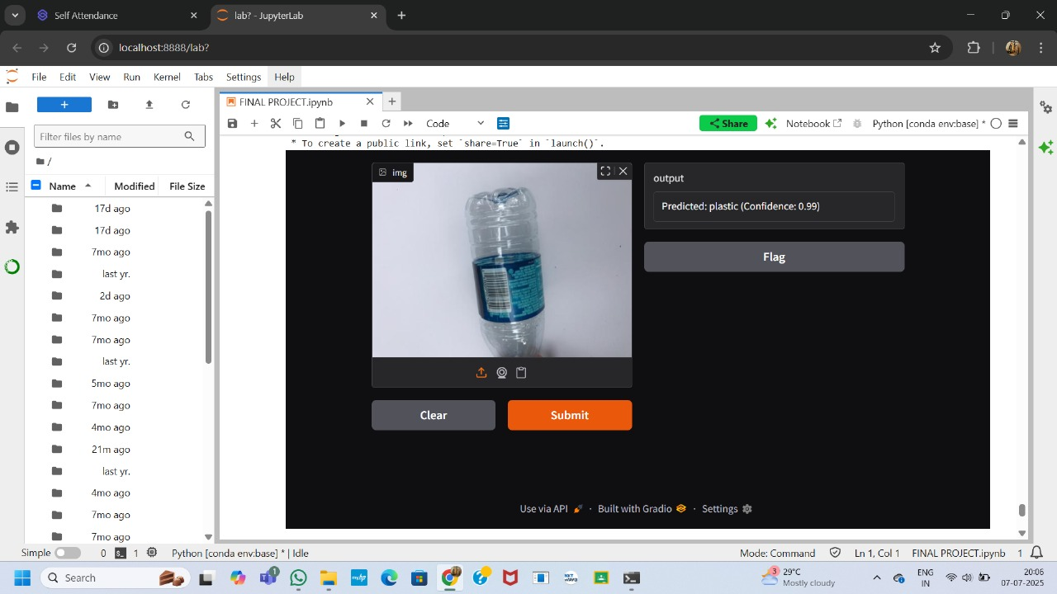
Screenshot of Output:

Slide 8
Conclusion:
This project showcases how Artificial Intelligence can improve waste segregation through image classification. By applying transfer learning and a user-friendly interface, the system enables fast and accurate garbage classification. It reduces manual effort and supports better recycling practices, contributing to a cleaner environment and sustainable waste management.

Slide 9
GitHub Link:
https://github.com/NarendarKoratla/Week-3-Final-Project.git

